Slide 1
Near Earth Objects
How to avoid annihilation 100% of the time!

Slide 2
The problem
Near Earth Objects
Context
Hazardous to Earth?
NEO’s can be any space object like a comet or asteroid.
This dataset is about asteroids. Rocks traveling around the sun of varying size.
Asteroids:
- Can be small or large
- Travel fast or slow
- Have different orbits
-Be difficult to see
Do these objects traveling in space present a threat to Earth?
If only dinosaurs had machine learning.

Slide 3
Exploring the data
dataset
cleaning
feature reduction
Over 4600 NEOs
- 40 features for each object
All data present
- no imputation required
Redundant data
- eliminating similar data
- highly correlated features

Slide 4
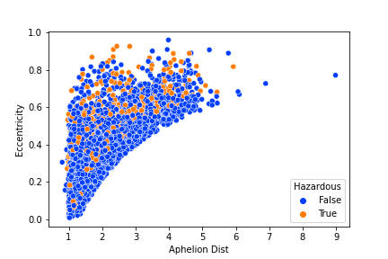
Looking for patterns in the data

Slide 5
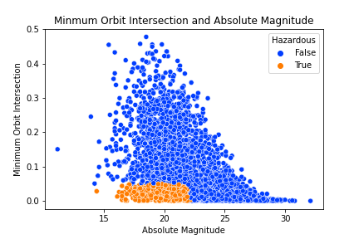
Key finding

Slide 6
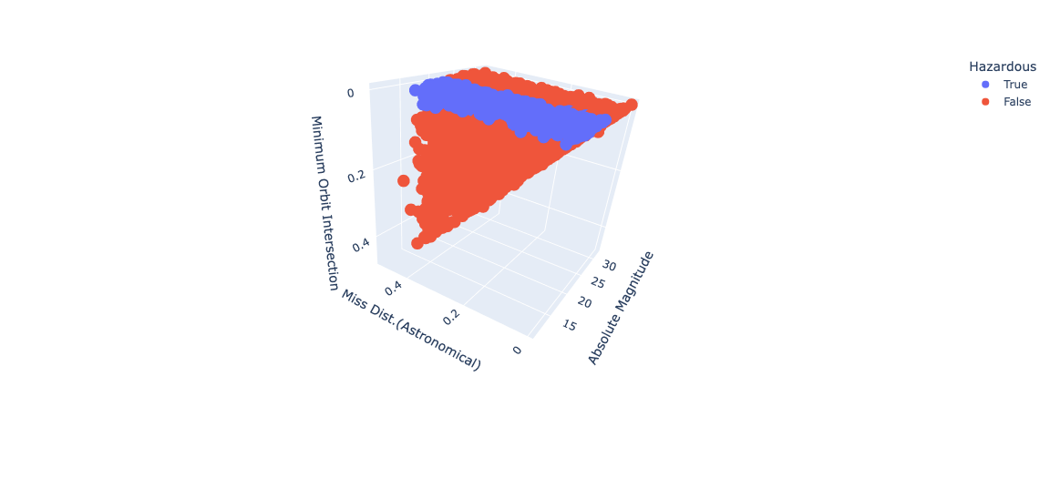
Hazardous asteroids

Slide 7
Baseline
Create a model with limited features from the findings. Use this baseline value to judge the accuracy of the final classification model.
A simple model

Slide 8
Success
Baseline model detected all hazardous asteroids
Decision tree with two features had 100% accuracy
Challenge
Create a model without two key features
Protect Earth from hazardous asteroids

Slide 9
Drop 2 key features from the dataset
Address class imbalance
Tune best models for improved performance
Update data
Normalize
Balance
Model
Tune
Normalize skewed features
Create 4 potential models

Slide 10
XGBoost Model
Models for protecting Earth from destruction need to be better.
94.5% accuracy

Slide 11
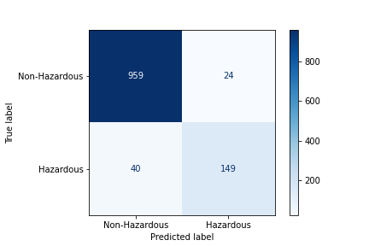
False Negatives
40 asteroids were classified as safe, but ended up destroying Earth.

Slide 12
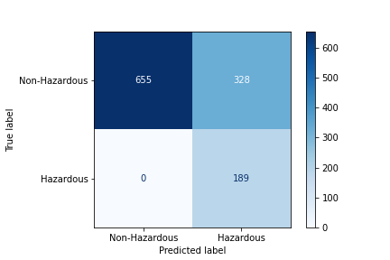
Reducing False Negatives
0 False negatives
328 False positives

Slide 13
Decision Tree
Hazardous!!!
A basic decision tree model will protect Earth from destruction.

